Slide 1
D.A.R.K. Lock
(Dual Authentication RFID Keypad)
By Youri Lavoie

Slide 2
Motivation
Necessity to conceptualize and build a project
Desire to create a practical, commonly used device
Door security systems are widely used in professional/residential settings
Deepen knowledge of Arduino

Slide 3
Outline
Introduction
Block Diagram
ATMega644P, Keypad
Power
PN532 RFID, TFT LCD
Buzzer, Solenoid
Layout
Milestones

Slide 4
Introduction
Utilizes dual authentication for maximum security/versatility
RFID tag/card = Physical authentication
PIN = Knowledge-based authentication
Easy to use
Audio and visual feedback is quickly provided to the user in the form of instructions, failure and success cues

Slide 5
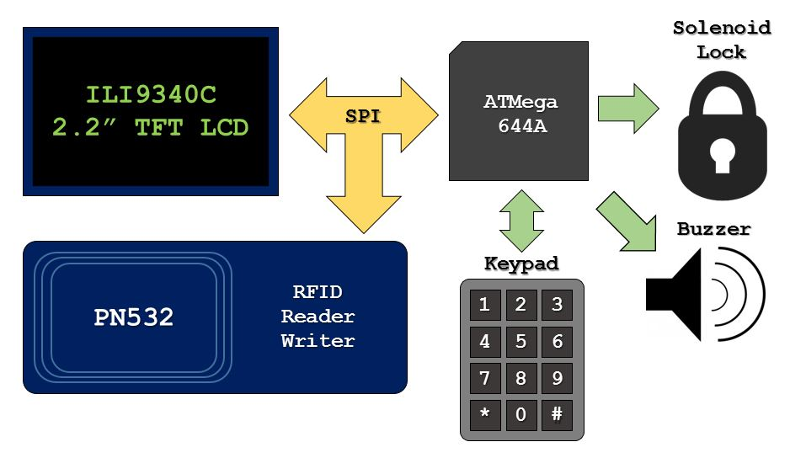
Block Diagram

Slide 6
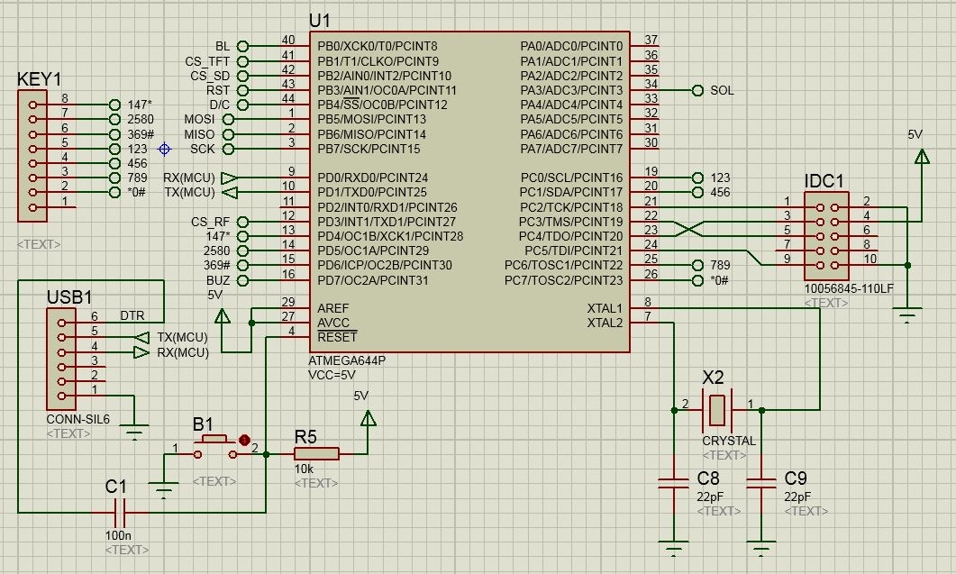
ATMega644P, Keypad
AtMega644P
Powered by Sanguino
Bootloader configured via JTAG
Programed via USB to Serial converter
16MHz Crystal
Keypad
4x3 matrix style

Slide 7
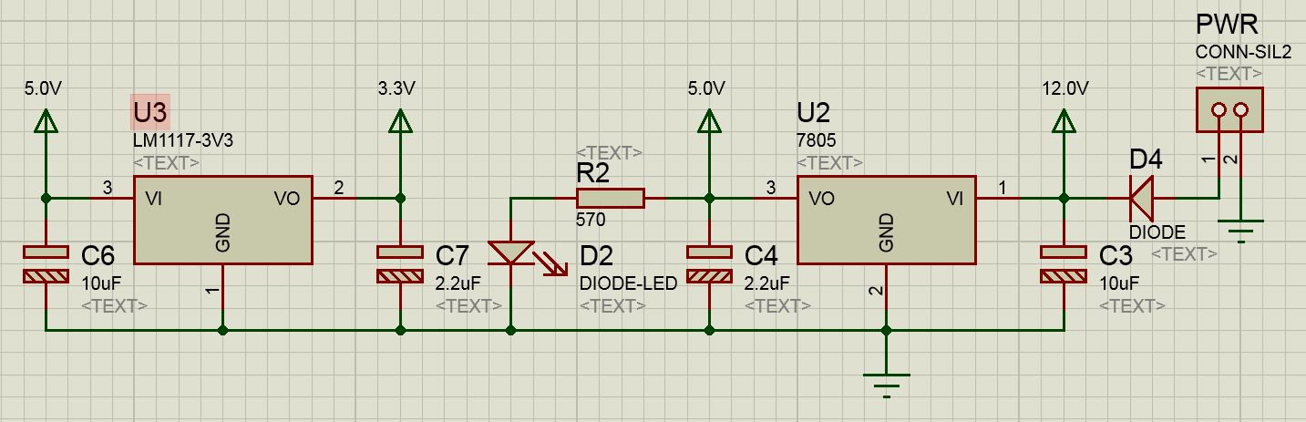
Power
12.0V – 2.0A from wall adapter, used by solenoid
5.0V, used by MC, buzzer, TFT LCD
3.3V, used by PN532 board
Power LED for diagnostics

Slide 8
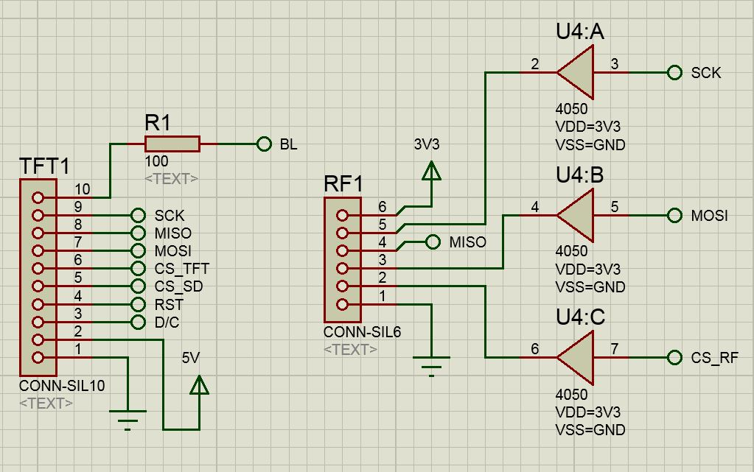
PN532 RFID, TFT LCD
PN532 RFID
Reader/Writer breakout board
Uses 3.3V
Communicates via SPI
Uses 4050 buffer to reduce 5.0V signals from MC to 3.3V
TFT LCD
2.2” TFT LCD display
Uses 5.0V, but can also use 3.3V
Communicates via SPI
Allows for clearer visual output to users
Included SD Card slot support on breakout board

Slide 9
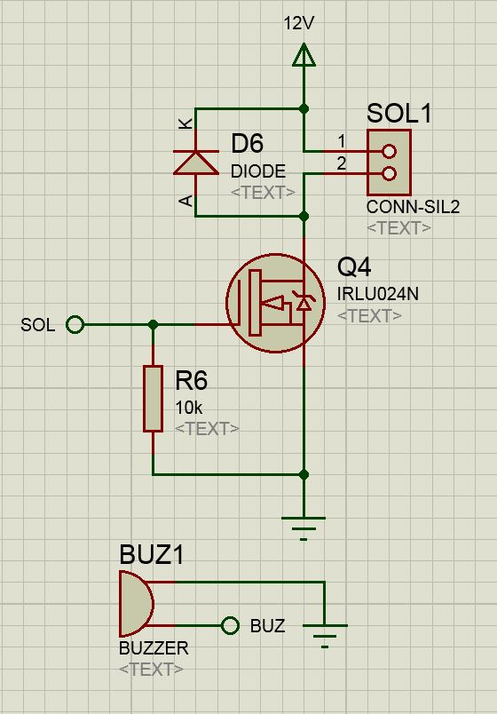
Buzzer, Solenoid
Buzzer
Uses PWM pin from MC to generate different audio cues
Solenoid
Fail-secure electromagnet
High current rushes through coil generating strong electromagnetic field, causing bolt retracting motion
Spring re-engages bolt after current ceases to be supplied to coil

Slide 10
Layout
Mostly surface mount (excluding headers, push button, and crystal)
Surface mount advantages
More compact design
Low component height allows for PCB to be contained below TFT breakout board
Surface mount disadvantages
More difficult to solder
Requires more research for components to replace previously planned through-hole components

Slide 11
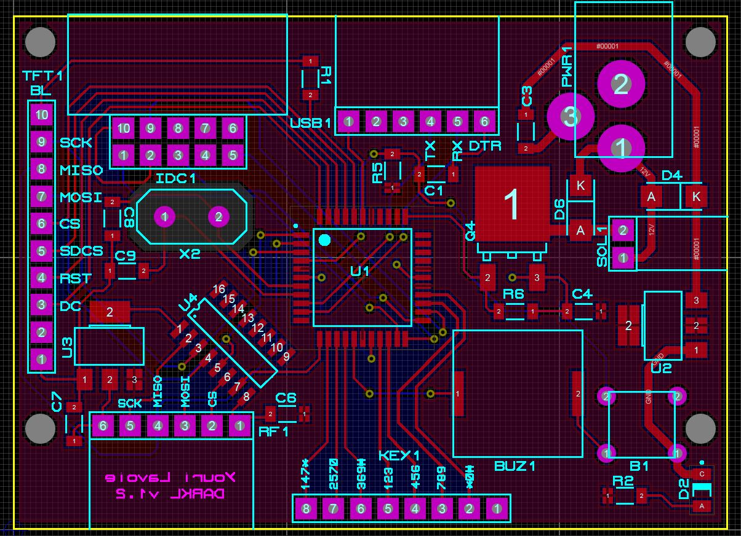
Layout

Slide 12
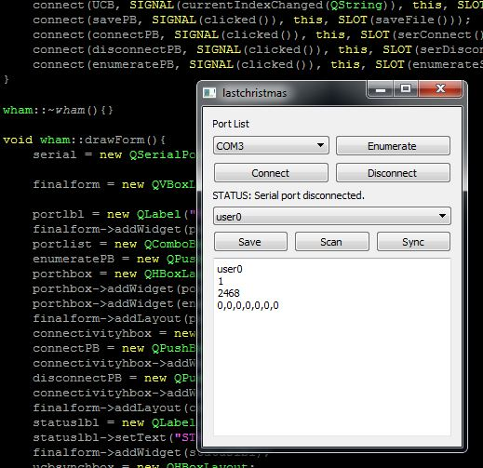
GUI
Still WIP and very barebones
Basic serial controls
Writes up to 10 users’ details to microcontroller EEPROM
User details stored in .txt files selectable through combo box
Line 1: Username
Line 2: Whether or not user is active
Line 3: PIN
Line 4: RFID tag unique identifier (UID)
Writing anything other than the intended values will cause the lock to not work properly

Slide 13
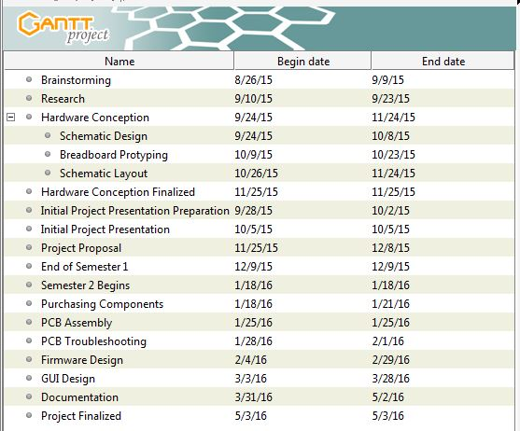
Milestones
Currently behind schedule
GUI still WIP

Slide 14
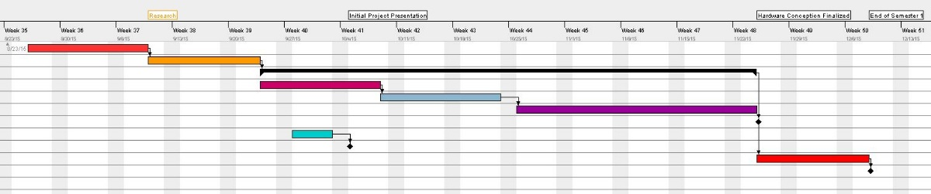
Milestones (1st Semester)

Slide 15
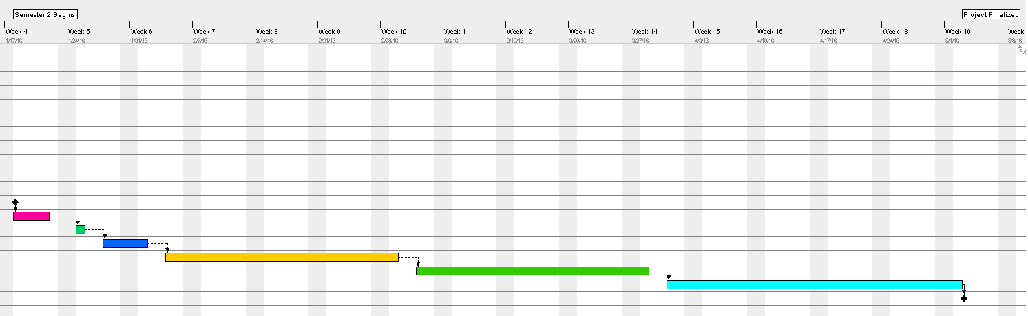
Milestones (2nd semester)

Slide 16
Proposed Improvements
Revision v1.0 was riddled with minor issues, but was functional
Revision v1.2 addressed those issues
Adapted TFT header to accommodate for compatible LCD
Changed horizontal headers to correct pitch
Buzzer actually connected to PWM pin
No components on bottom copper
Optimized component and mounting hole positioning
Striker lock solenoid would be better for real world implementation
Using components rated for outdoor use would increase viable deployment locations
Placing device in an enclosure

Slide 17
QUESTIONS?
Thank you for listening.

